Slide 1
















SightPay
DEPI Final Project
Supervised By: Eng.Mahmoud Talaat Mahmoud

Slide 2

TEAM MEMBERS
Ahmed Mohammed
Yossef Abdelmajeed
Jehan Khalil
Mariam Zaki

Slide 3
AGENDA
Objective
Methodology
Tools
01
02
03
04
04
05
06
Introduction
Problem & Solution
Demo
Future Work

Slide 4
INTRODUCTION
Visually impaired individuals often face significant challenges in managing everyday financial tasks, such as handling invoices and monitoring expenses. These tasks, which are straightforward for most people, become complex and cumbersome without visual assistance, leading to a dependence on others and potential risks of errors or fraud.

Slide 5

OBJECTIVE
Our project aims to bridge this gap by creating an AI-powered solution that empowers visually impaired individuals to independently manage their invoices and finances. By leveraging advanced machine learning, image recognition, and voice assistance technologies, we provide users with a seamless and accessible way to capture invoices, verify their details, calculate totals, and compare them with available funds—all through simple voice commands.

Slide 6

Problems
Solutions
Difficulty in determining the amount to be paid inability to identify categories of money
Difficulty in determining the amount to be paid inability to identify categories of money
Inability to Read Bills
Visually impaired individuals often face challenges in reading and understanding printed invoices or bills without assistance.
Inability to Read Bills
Visually impaired individuals often face challenges in reading and understanding printed invoices or bills without assistance.

Slide 7


Slide 8

Text
Extraction
Invoice
Detection
Image
Processing
OCR (Optical Character Recognition)
Real-Time
Feedback
Structured Data Extraction

Slide 9
OCR (Optical Character Recognition)
Invoice Detection: Automatically identifies whether an image contains an invoice.
Text Extraction: Extracts relevant financial information such as total amount, item descriptions, quantities, and unit prices from the invoice.
Image Processing: The captured image is processed by the OCR engine.
Structured Data Extraction: Data is extracted in a structured format like JSON (e.g., items ordered, their quantities, and total).
Real-Time Feedback: Provides immediate voice feedback to ensure accessibility for visually impaired users.

Slide 10
Speech Recognition And Voice Assistance
Natural Voice Commands
Speech
Feedback
Seamless
Workflow

Slide 11
Speech Recognition And Voice Assistance
Natural Voice Commands: Users can issue commands like capturing invoices, requesting total amounts, listing items, and checking balances.
Speech Feedback: The system reads out invoice details, totals, and transaction statuses to provide verbal feedback.
Seamless Workflow: Allows users to extract totals, verify payments, and check funds—all through voice interaction.

Slide 12









PIPELINE
CURRENCY DETECTION
Speech
text-to-speech
Speech
Speech-to-text
INVOICE READER

Slide 13
METHODOLOGY
Data Visualization
Models
02
04
01
03
05
Data Collection
Data Processing
Results

Slide 14
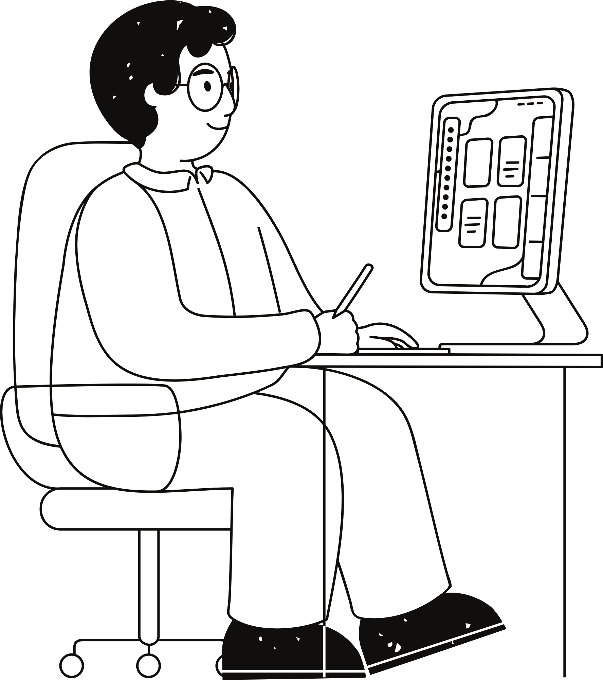
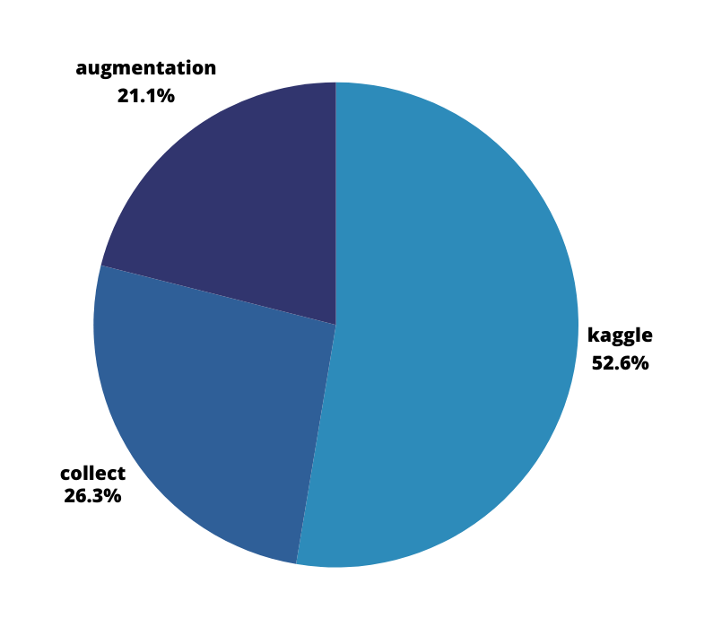
Data Collection
1.kaggle dataset 2,005
2.collect manual data 983
3.data augmentation 599
Total images=3,587

Slide 15
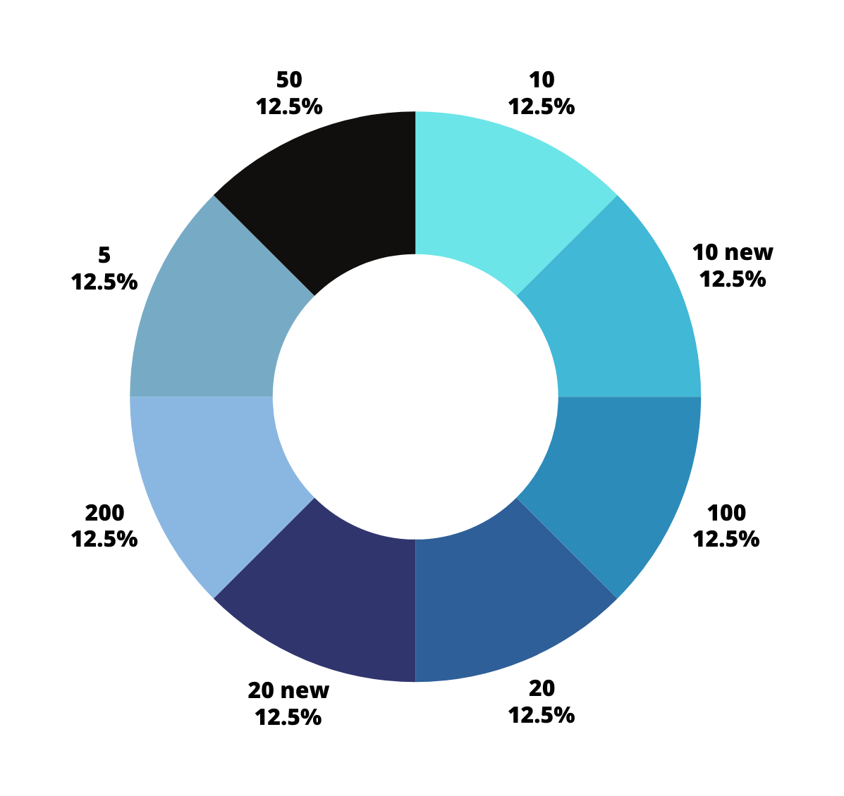
Data Visualization
Classes:
['10' '10 (new)' '100' '20'
'20 (new)' '200' '5' '50']
Number of classes: 8

Slide 16
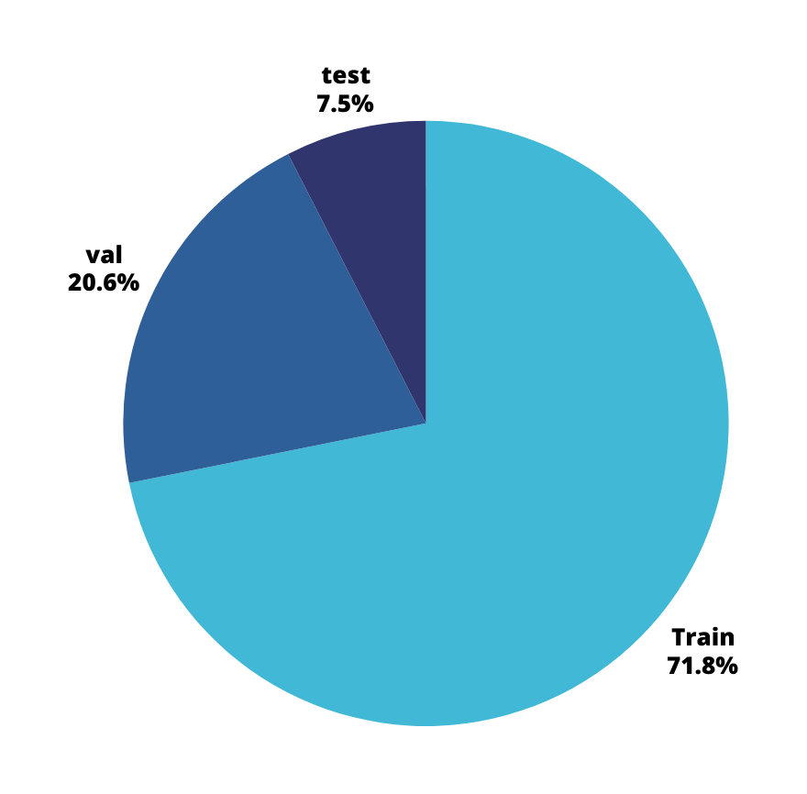
Train & Validation & Test
Dataset: Train Number of images:
2577 Image shapes: (2577, 224, 224, 3)
Dataset: Validation Number of images:
740 Image shapes: (740, 224, 224, 3)
Dataset: Test Number of images:
270 Image shapes: (270, 224, 224, 3)

Slide 17
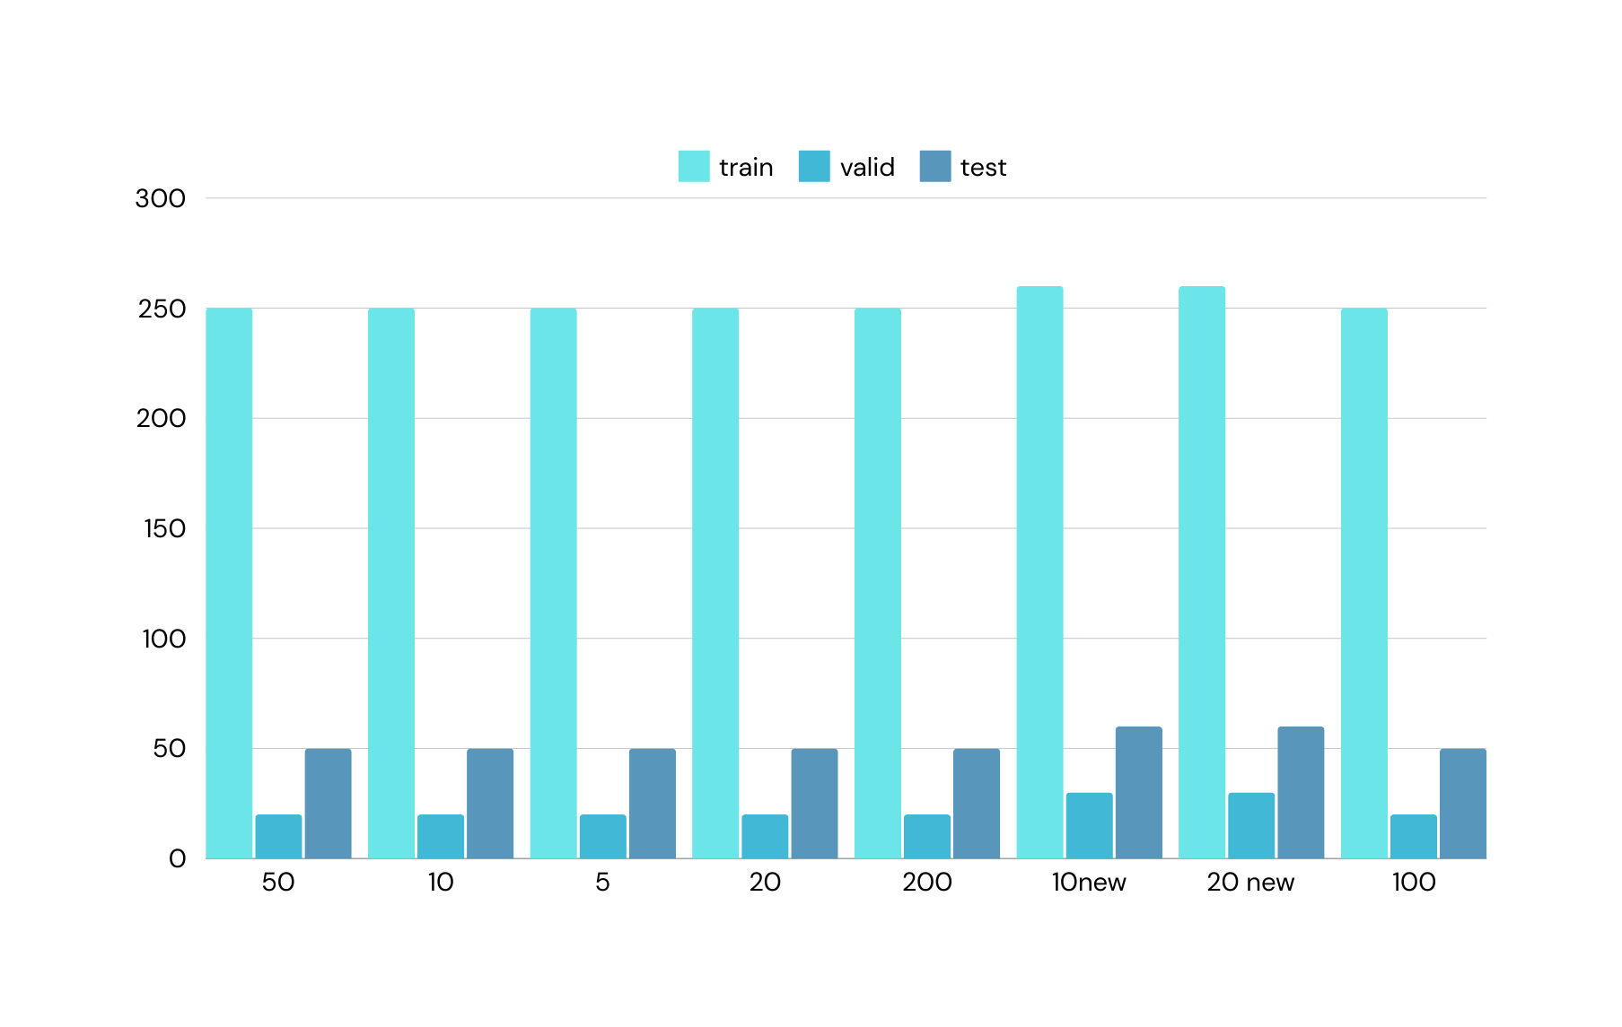

Slide 18
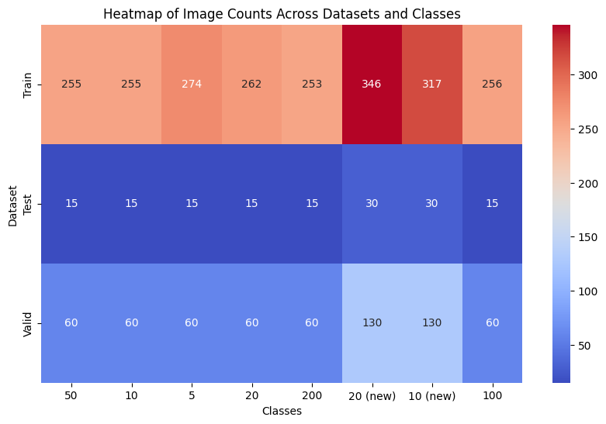
Heatmap of Image Count Across Classes and Sets

Slide 19
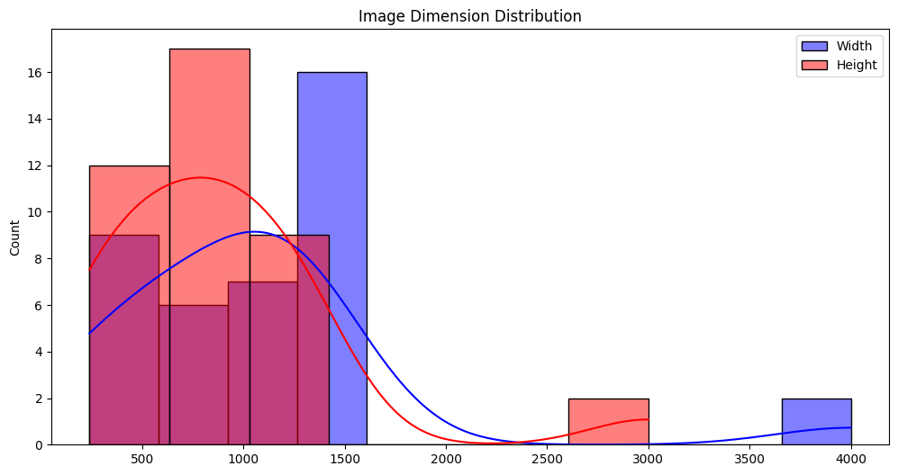
Analyze image properties (dimensions, pixel intensity distribution, etc.)
Most images have dimensions between 500 to 1500 pixels. There are a few images with much larger dimensions (around 3000 for height and 3500–4000 for width), which may represent outliers

Slide 20
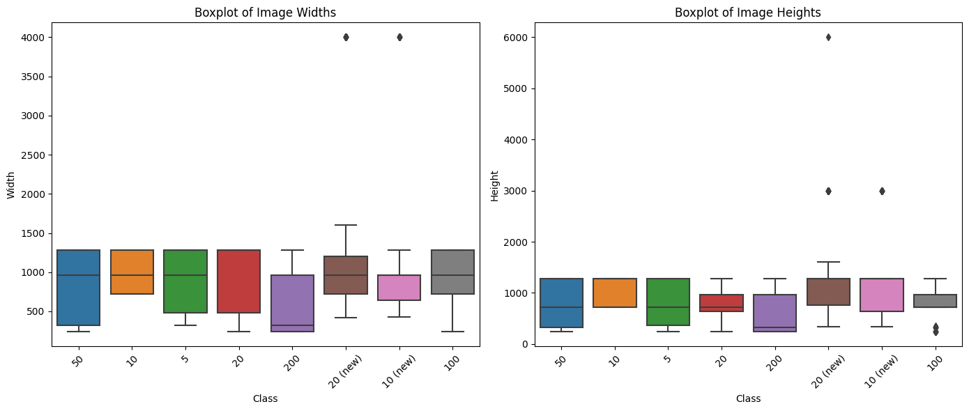
Box Plot of Image Dimensions

Slide 21
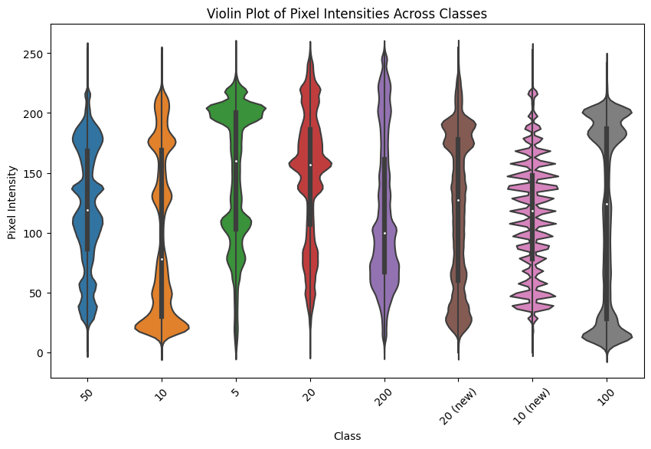
Violin Plot of Image Pixel Intensities

Slide 22
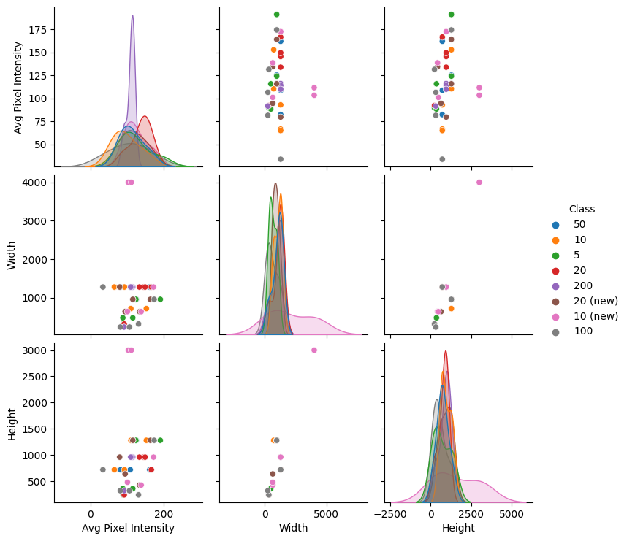
Pair Plot for Multivariate Analysis
extract some image features you can create a pair plot to explore relationships between these features

Slide 23
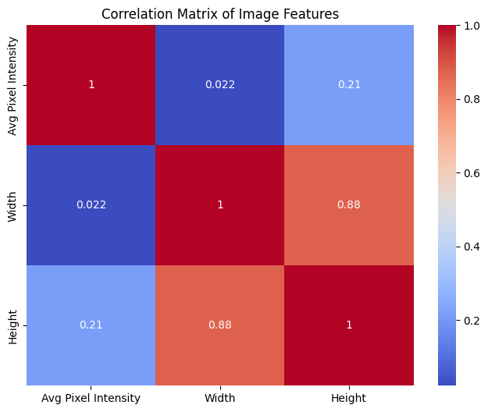
Correlation Matrix for Image Features

Slide 24
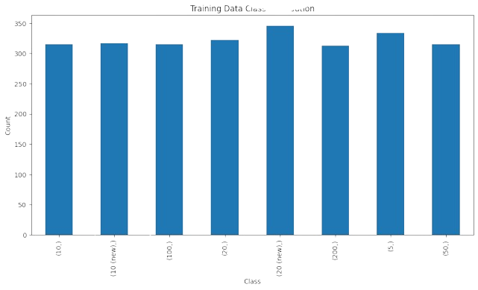
Train data
balance data

Slide 25
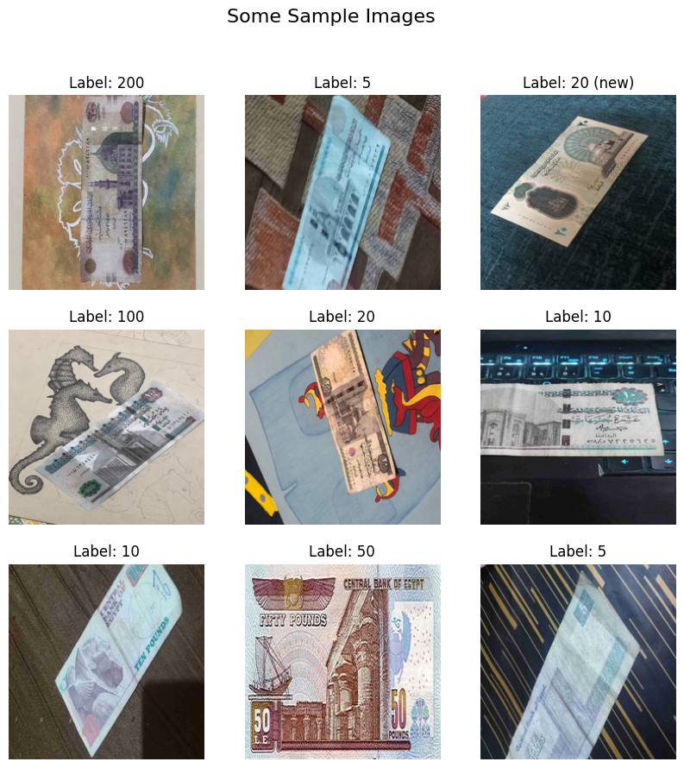
Some Sample Images

Slide 26

Models
CNN
InceptionV3
VGG16
yolov8n
EfficientNetV2L
ResNet152V2

Slide 27
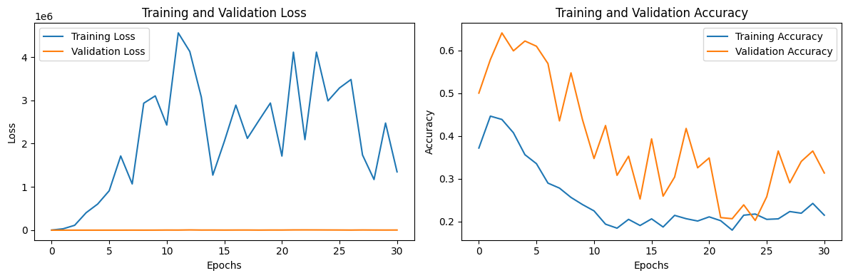
VGG16
base_model = VGG16(weights='imagenet', include_top=False, input_shape=(IMG_SIZE, IMG_SIZE, 3))
loss: 1.5701 - accuracy: 0.5852

Slide 28
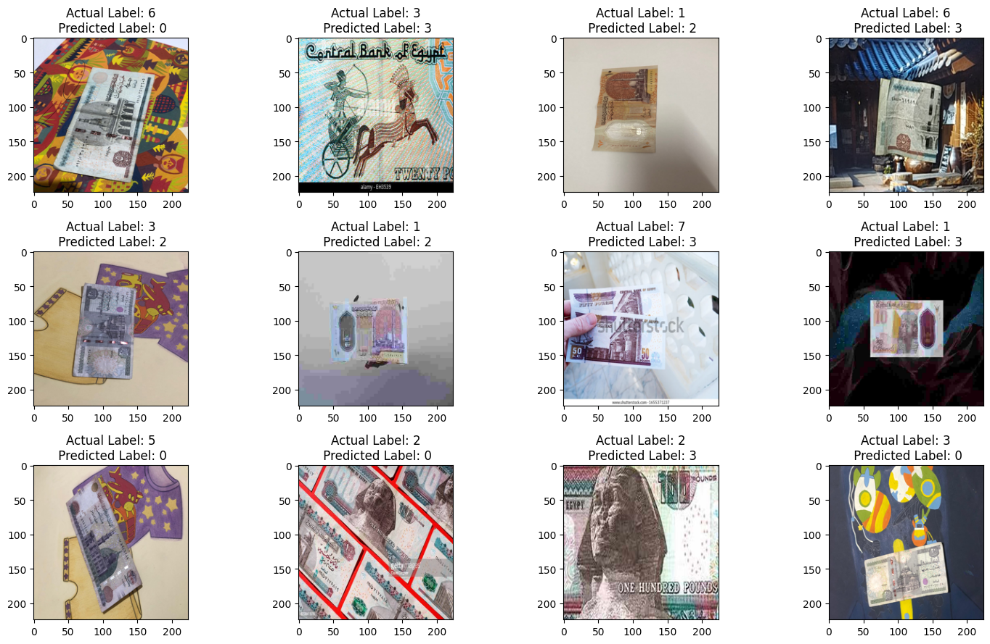
Model
Prediction

Slide 29
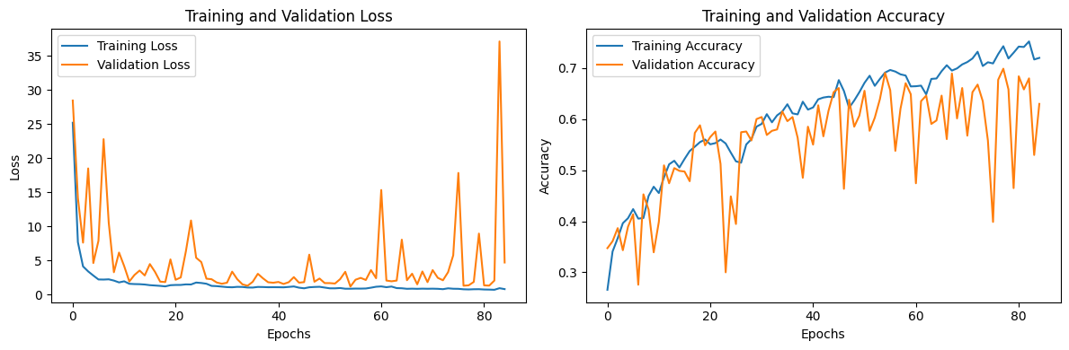
CNN
Convolutional Neural Network (CNN) architecture with 17 layers. Each layer has its own set of parameters, contributing to the overall complexity and functionality of the network.
input:(None,256)
output:(None,8)
loss: 2.1192 - accuracy: 0.6741

Slide 30
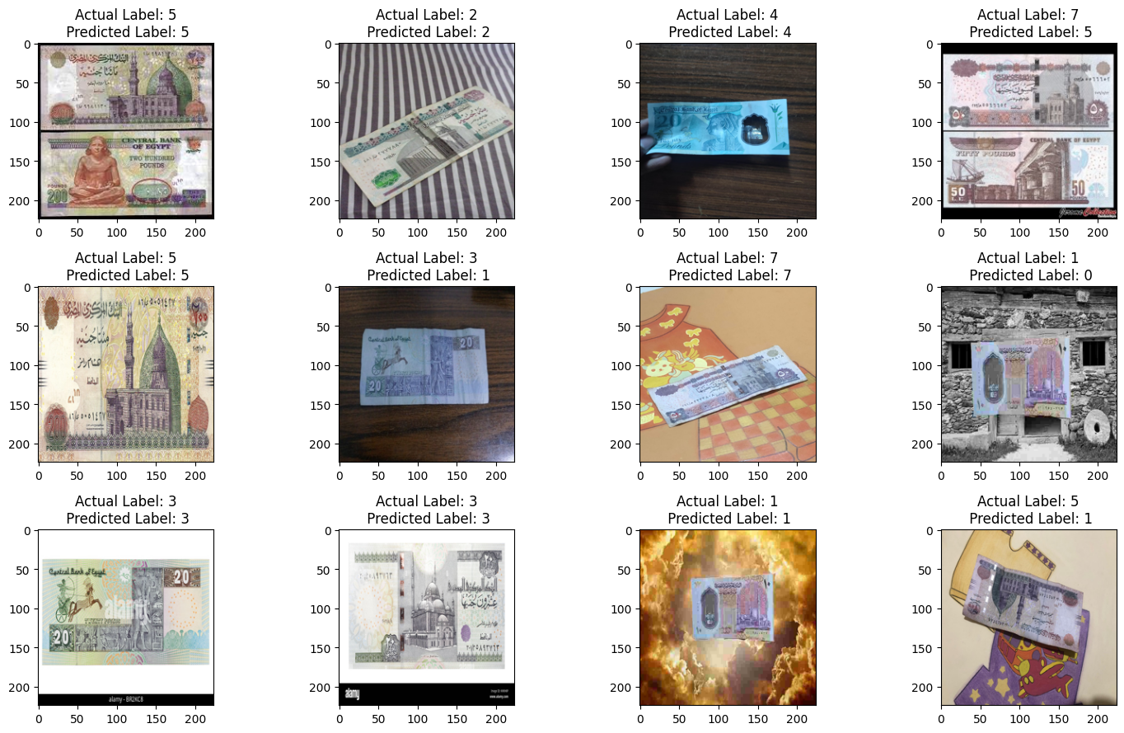
Model
Prediction

Slide 31
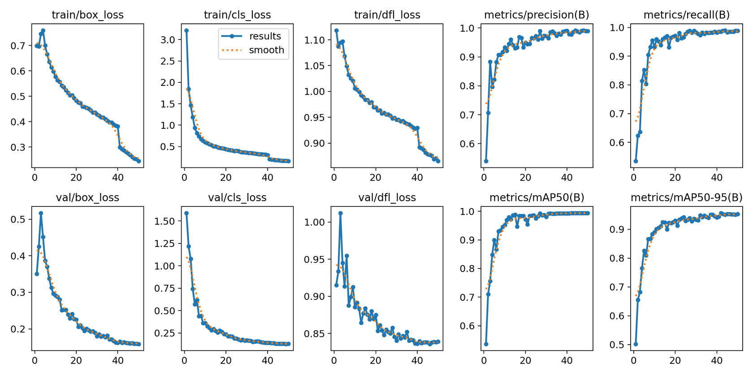
yolov8n
model.train(data='/kaggle/input/new-egyptian-currency/data.yaml', epochs=50, imgsz=640, batch=16)

Slide 32
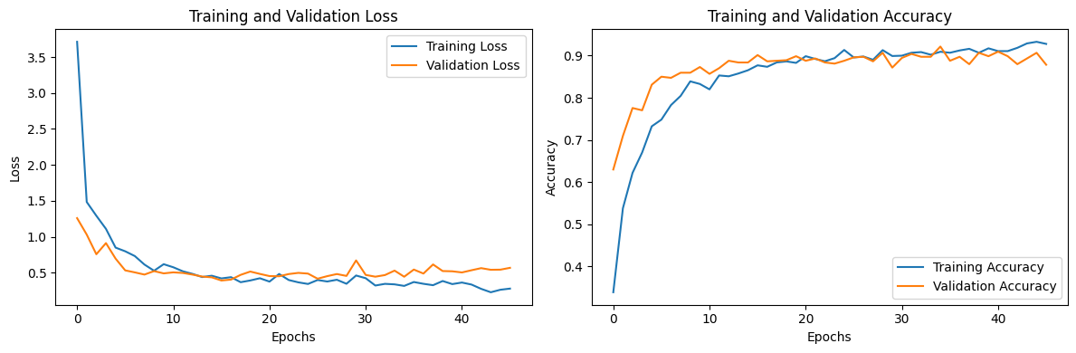
EfficientNetV2L
base_model = EfficientNetV2L(weights='imagenet', include_top=False, input_shape=(IMG_SIZE, IMG_SIZE, 3))
loss: 0.2384 - accuracy: 0.9370

Slide 33
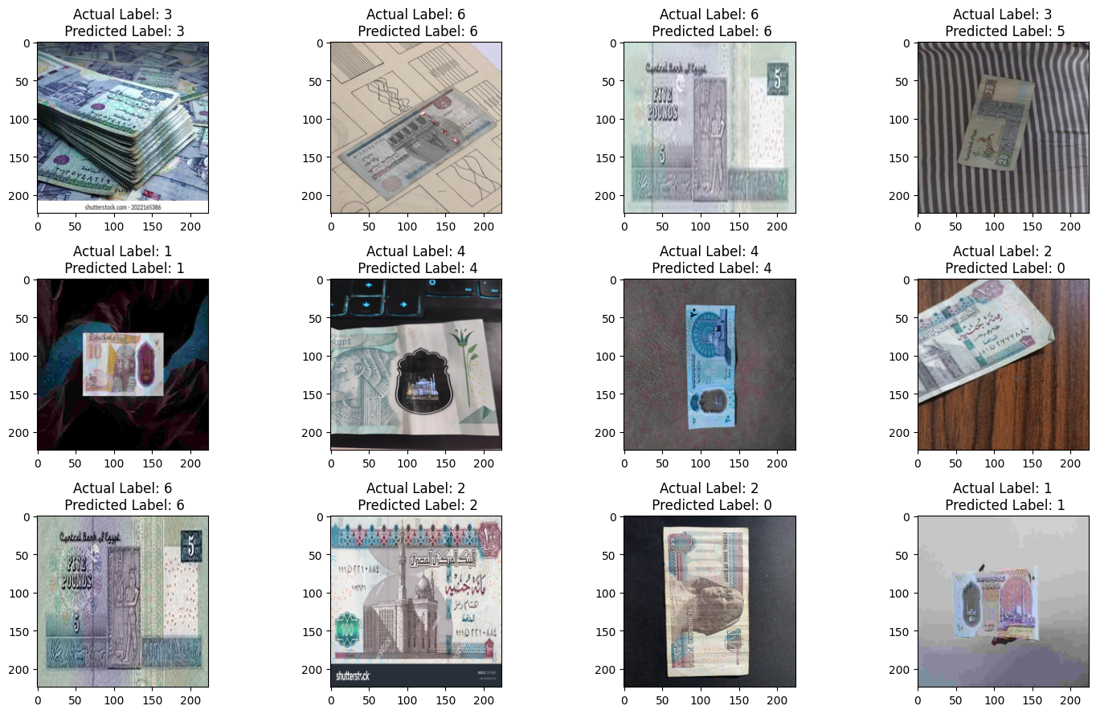
Model
Prediction

Slide 34
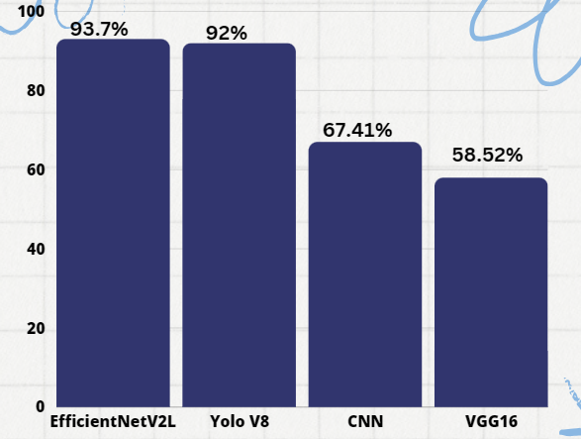
Models
Accuraccy

Slide 35
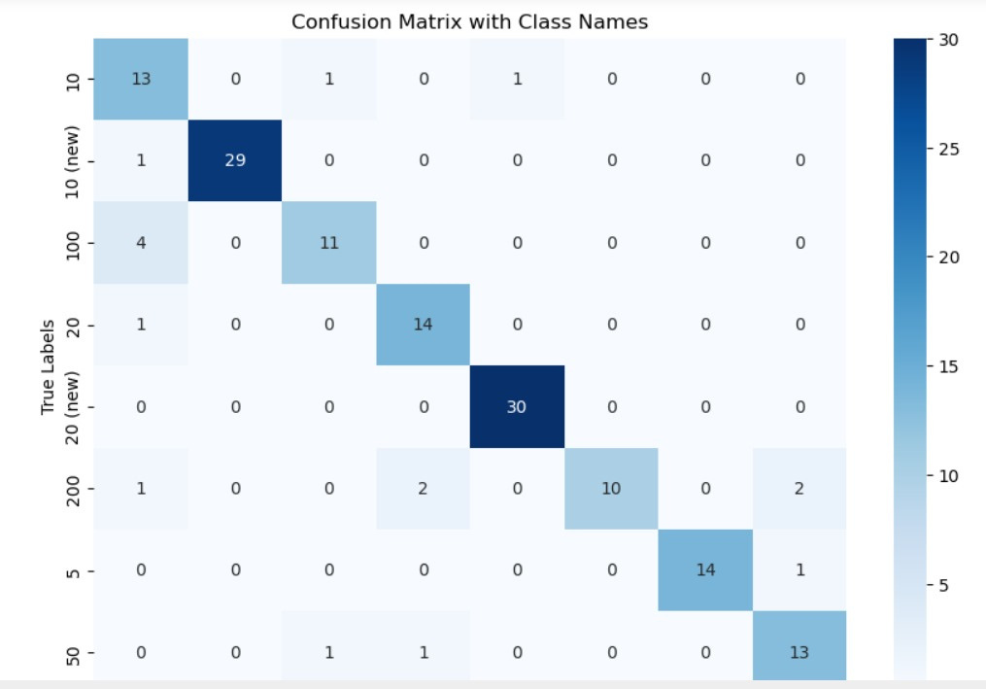
Results
EfficientNetV2L

Slide 36
Future Work

Slide 37





TOOLS
Google Cloud
Gemini
GitHub
Google Colab
Kaggle

Slide 38
Thank You Very Much!

